Slide 1
Installing Database Clients

Slide 2
Installing PgAdmin

Slide 3
Download PgAdmin
You can download from here
  https://www.pgadmin.org/download/
Windows
  https://www.postgresql.org/ftp/pgadmin/pgadmin4/v6.19/windows/
Mac
  https://www.postgresql.org/ftp/pgadmin/pgadmin4/v6.19/macos/

Slide 4
Windows Install (Overview)
Installing in your local user directory is fine
  Only do “for all users” if you have admin privileges
Accept the defaults
This will install another Python on to your computer that will run its own app

Slide 5
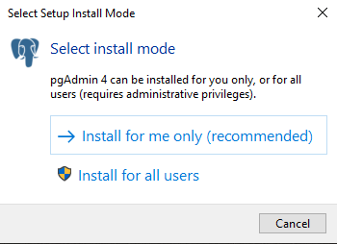
Install mode

Slide 6
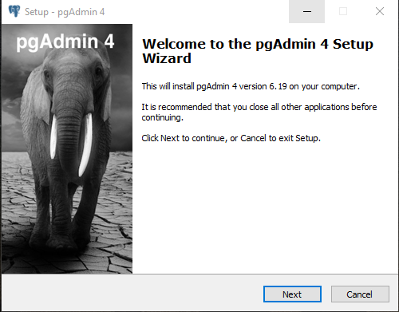

Slide 7
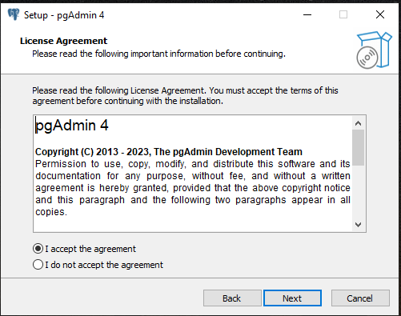

Slide 8
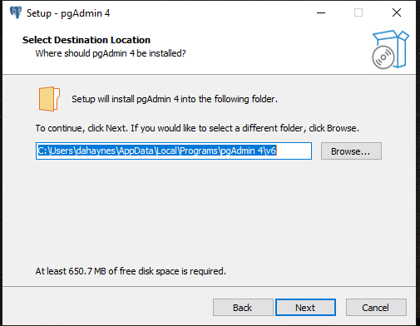

Slide 9
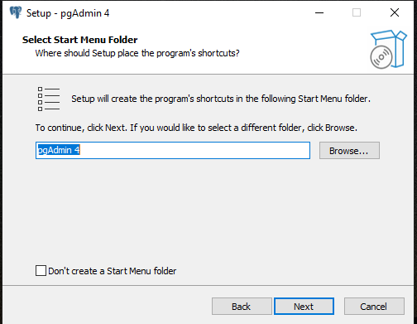

Slide 10
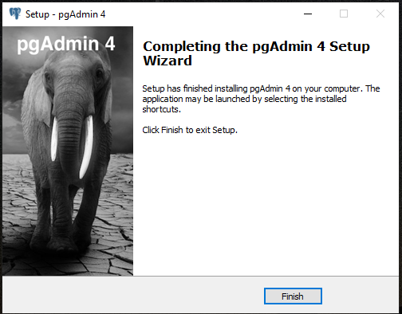

Slide 11
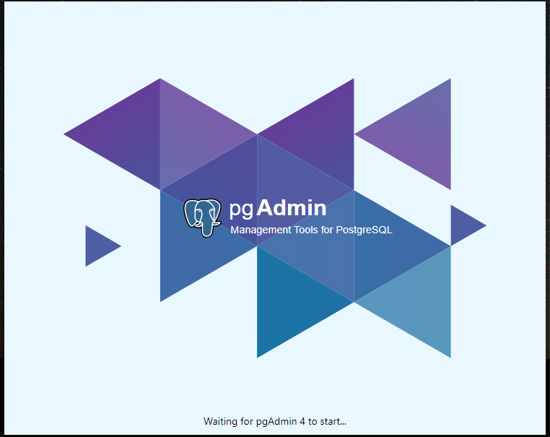
Success

Slide 12
Connecting to Remote Server

Slide 13
Connecting to Remote Server
Click on “Servers”
Add New Server
Complete Connection Information
  General
    Name: “GIS 5577” (it can be anything you want)
  Connection – See Canvas Xsede server information
    Host address
    Port: 5432
    Username: “x500” (do not add the @umn.edu)
    password

Slide 14
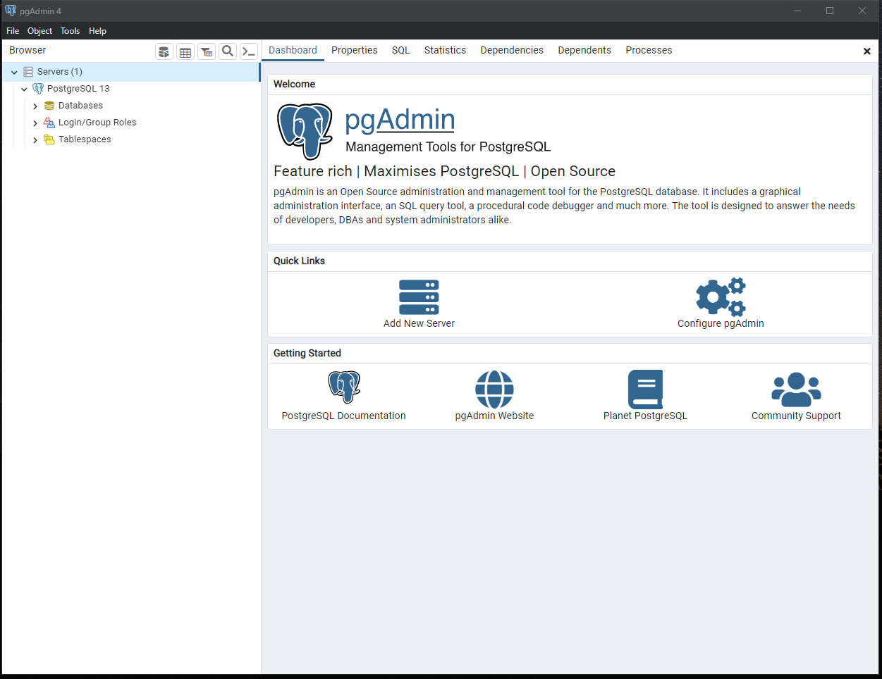
Connecting to Remote Server
Click on “Servers”
Click “Add New Server”

Slide 15
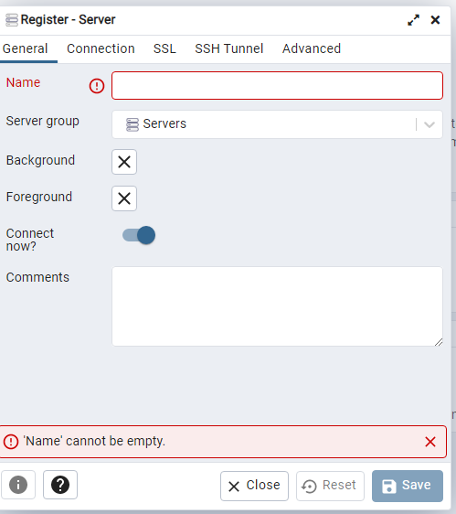
General Tab
Name: “GIS 5577” (it can be anything you want)

Slide 16
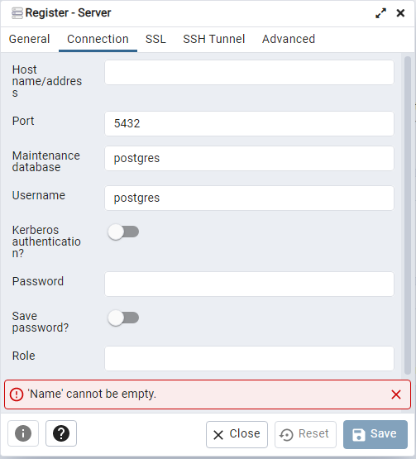
Connection Tab
Connection – See Canvas Xsede server information
  Host address
  Port: 5432
  Username: “x500” (do not add the @umn.edu)
  password

Slide 17
Installing DBeaver

Slide 18
Download Dbeaver Community
You can download from here
  https://dbeaver.io/download/
Windows
  https://dbeaver.io/files/dbeaver-ce-latest-x86_64-setup.exe
Mac
  https://dbeaver.io/files/dbeaver-ce-latest-macos-x86_64.dmg

Slide 19
Windows Install (Overview)
Installing in your local user directory is fine
  Only do “for all users” if you have admin privileges
Accept the defaults
  You do not need to check the extra check boxes
This client supports many types of databases
You will have to update the Java connection library

Slide 20
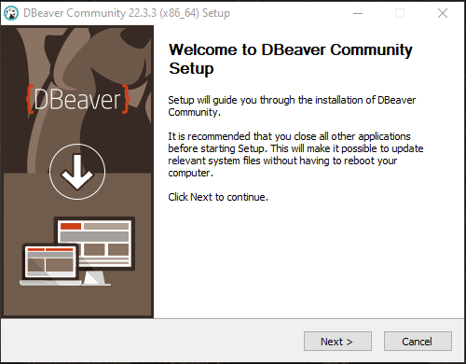

Slide 21
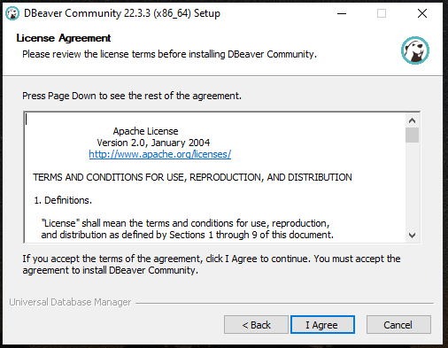

Slide 22
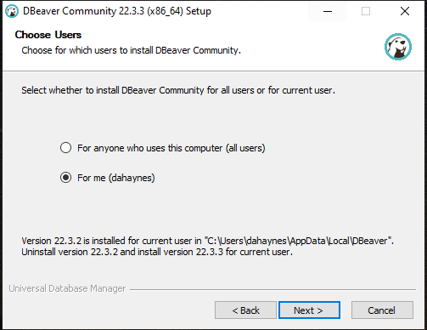

Slide 23
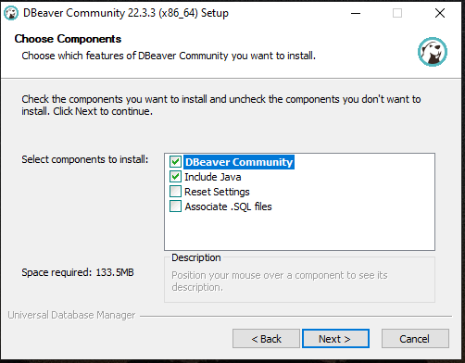

Slide 24
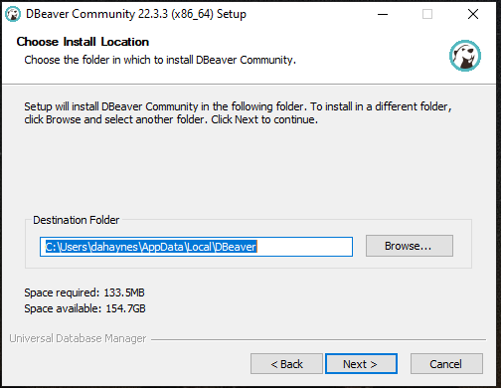

Slide 25
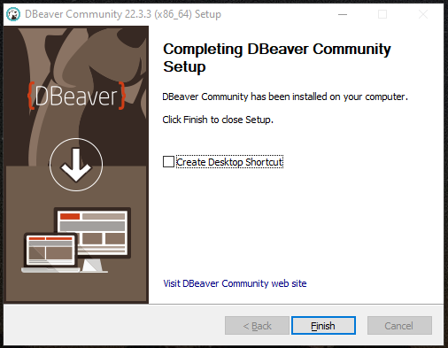
Success

Slide 26
Connecting to Remote Server

Slide 27
Connecting to Remote Server
Make a new Connection
  Choose PostgreSQL
Complete Connection Information
  Connection – See Canvas Xsede server information
    Host address
    Database: “classroom”
    Port: 5432
    Username: “x500” (do not add the @umn.edu)
    Password
On the PostgreSQL tab choose “see all databases”

Slide 28
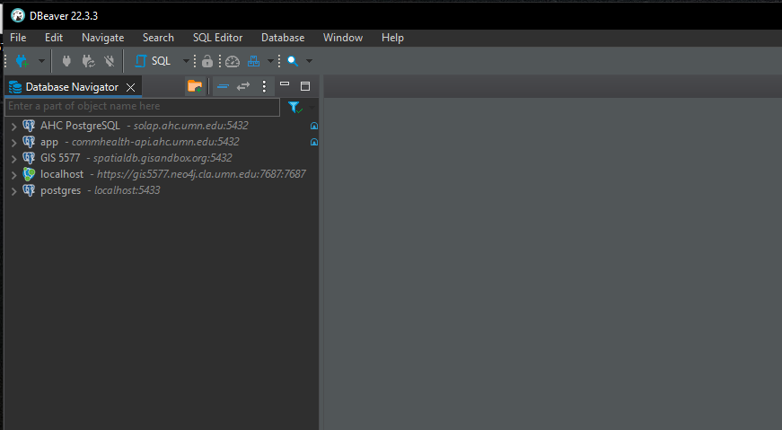
Make A Connection
Your panel will be blank
Click the “Connection” button

Slide 29
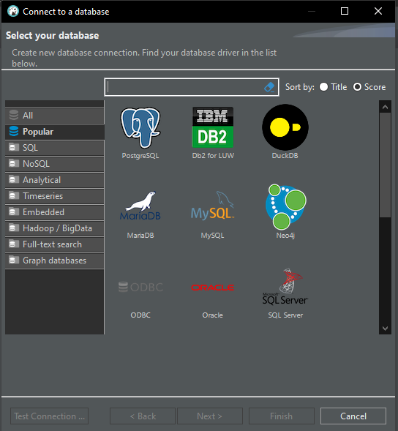
Choose the database type
PostgreSQL tends to be at the top, but you can search for it.
Choose PostgreSQL

Slide 30
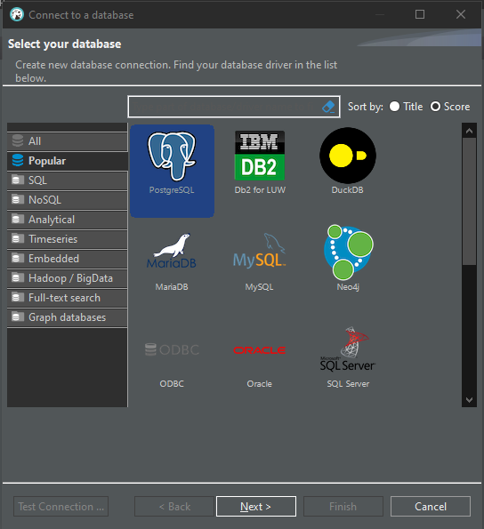
Selected PostgreSQL
Click Next

Slide 31
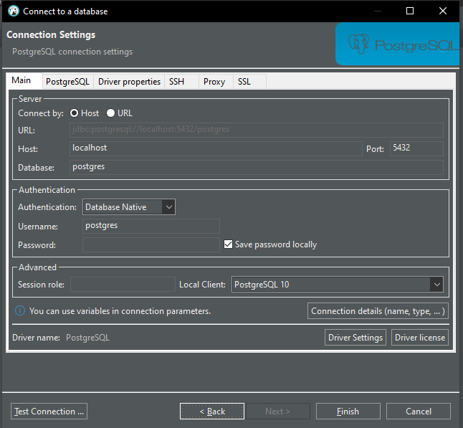
Main
Connection – See Canvas Xsede server information and password
  Host address
  Database: “classroom”
  Port: 5432
  Username: “x500” (do not add the @umn.edu)
  password

Slide 32
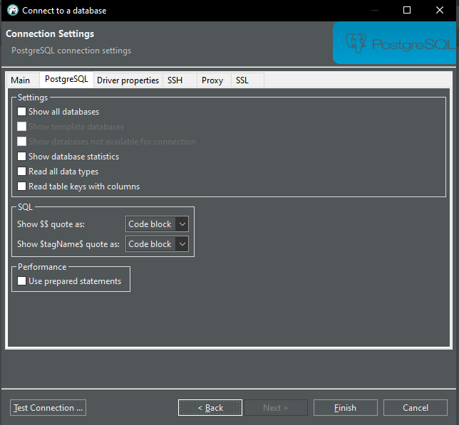
PostgreSQL
Click “Show all databases”

Slide 33
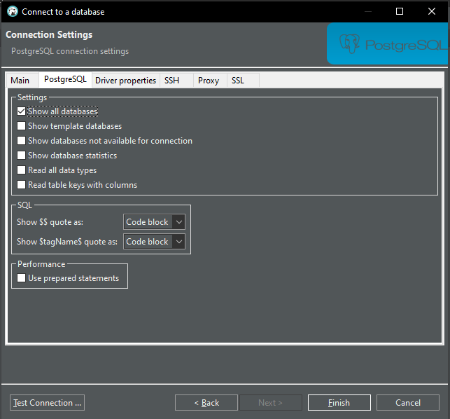
Test connection

Slide 34
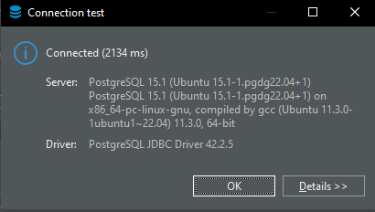
Success
If successful click Ok
On the main screen Finish the connection

